Slide 1
Market Strategy/Business Analysis
Marketing strategy is all about drafting a way to reach out to the targeted audience. Perhaps the best and most straightforward method is to follow McCarthy’s 4Ps of marketing for a New Product Development project.

Slide 2
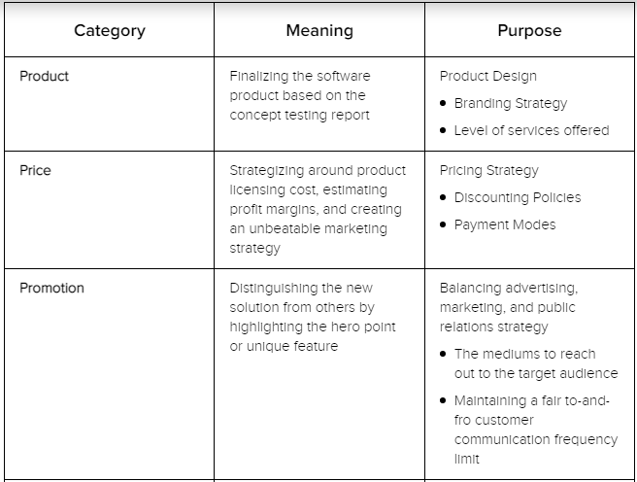
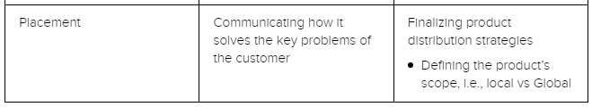

Slide 3

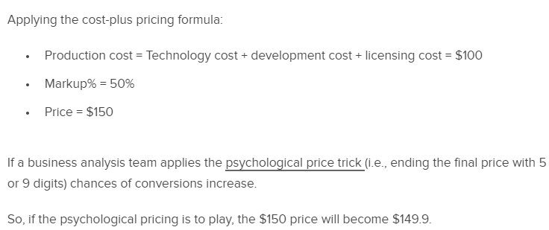
1. Cost-Based Pricing Model Here, the initial production cost is added to the markup percentage to come up with the new product’s final price.

Slide 4
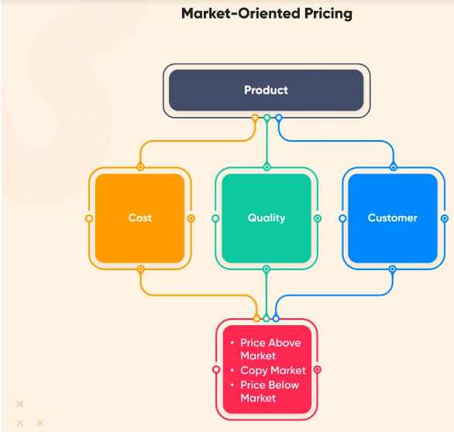
2. Market-Focused Pricing This pricing is inferred after a thorough analysis of the pricing model of similar products in the target market. The market-oriented pricing follows the trajectory:

Slide 5
